Slide 1
Disrupting Compulsory Sightedness THROUGH STEM OUTREACH & COMMUNICATION
Dr. Natalie L. Shaheen
nlshaheen.com/OSU

Slide 2

Access Invocation
1. ASL & CART
2. Slides: nlshaheen.com/OSU
3. Care for your body
4. Make some noise!

Slide 3
Sightedness Remains Compulsory
2000
HS Chem: You are BAD at science
2010
Blind Scientists: Chem class was inaccessible
2020
Blind Teen: Pushed out of mechanical engineering

Slide 4
Conspire with Us
Disrupt the Compulsory Sightedness of STEM

Slide 5
4 Questions
What is blindness?
How is sightedness compulsory in STEM?
How can STEM outreach and communication disrupt the compulsory sightedness?
How can you conspire with the blind community to change the unjust status quo in STEM?

Slide 6
What is blindness?

Slide 7

Reflect
What is blindness?
When does someone cross the line from sighted to blind?

Slide 8
3 Definitions
One is blind to the extent that he must devise alternative techniques to do efficiently those things which he would do visually if he had normal vision.
(Jernigan, 1962, n.p.)
Nonvisual
ways of
knowing
and being
(Shaheen)
    Visual acuity of 20/200 or less with correction
    OR
    Visual field less than 20 degrees in best eye
    (see 20 CFR § 404.1581)

Slide 9
How is sightedness compulsory in STEM?

Slide 10

Sightedness is assumed

Slide 11
Compulsory Abledness
CRIP THEORY
Nonidentity
Natural order of things
Ultimate aim
(McRuer, 2006)
Do you wish you were sighted?

Slide 12
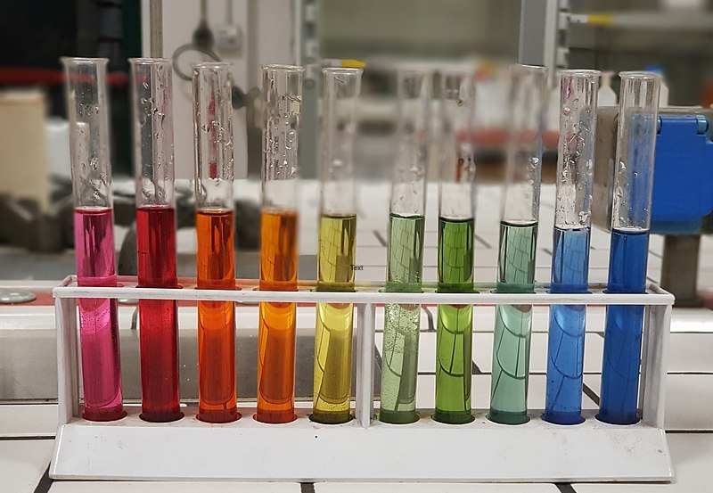
Wouldn’t you rather do STEM the sighted way?

Slide 13

STEM is Visual!

Slide 14
Reflect 1
Consider the STEM spaces you have experienced, in what ways did those environments communicate that STEM is “visual” or that sightedness is compulsory?

Slide 15

Share
Consider the STEM spaces you have experienced, in what ways did those environments communicate that STEM is “visual” or that sightedness is compulsory?

Slide 16

Let’s Observe

Slide 17
Reflect 3
How do the STEM outreach activities you facilitate communicate, explicitly or tacitly, that STEM is “visual” or that sightedness is compulsory?

Slide 18
Smart Grid for All (ISU)
Buildings only labeled in print
All power indicators were visual (lights)
Handouts only in print and inaccessible digital documents
Skills taught exclusively the visual way

Slide 19
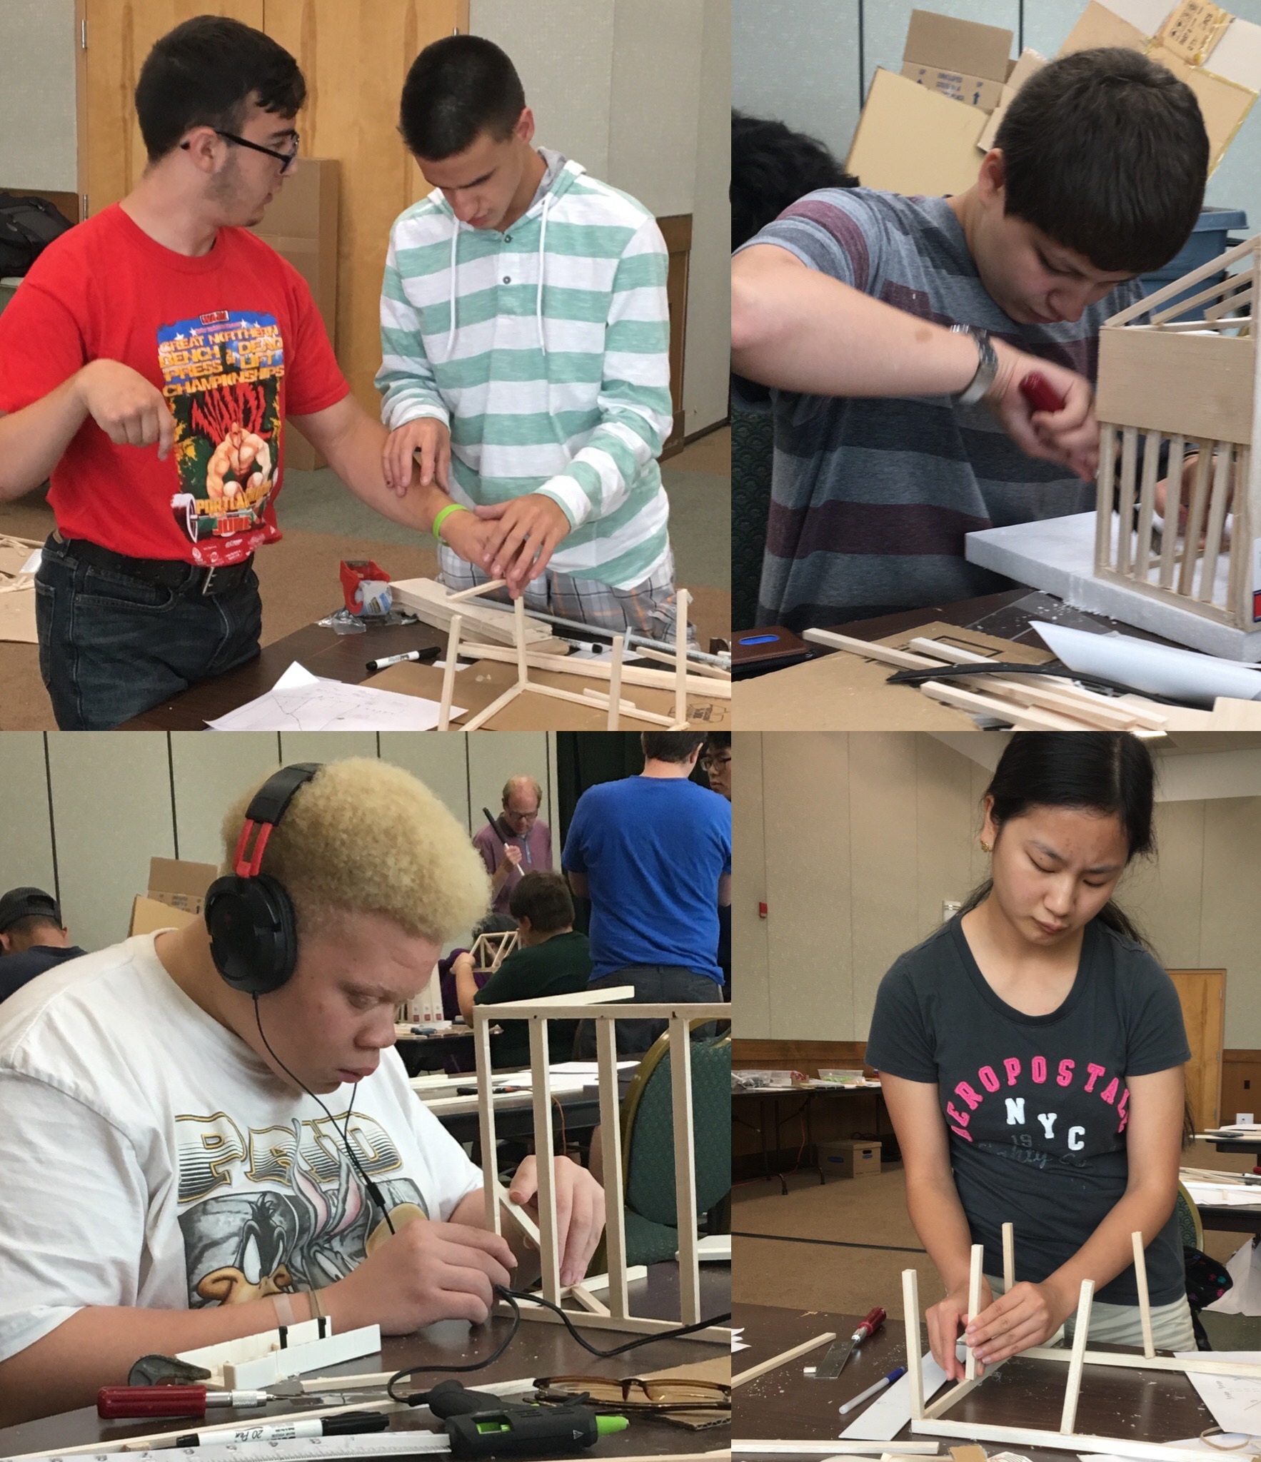
Expanding what it means to learn & Do STEM

Slide 20
How can STEM OUTREACH & COMMUNICATION disrupt the compulsory sightedness of STEM?

Slide 21
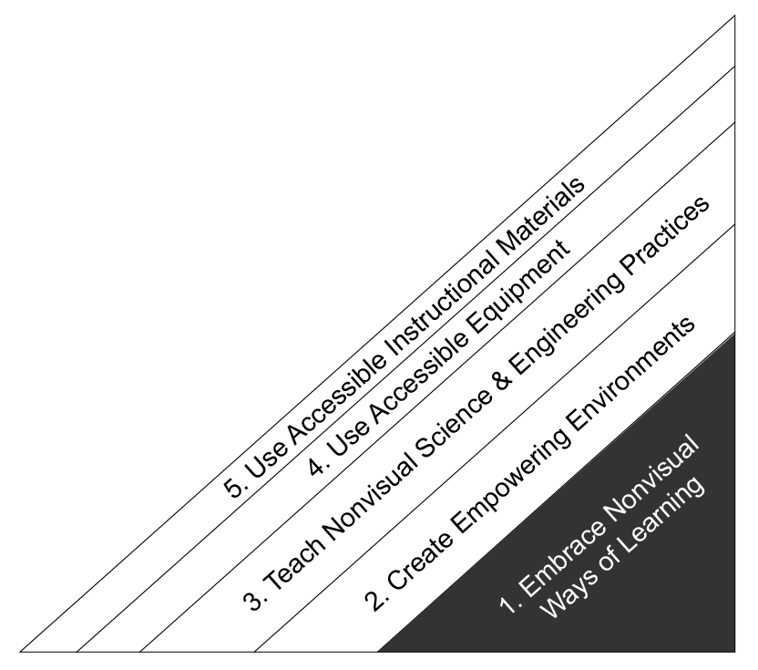
NFB STEM Programs
Sightedness is NOT compulsory

Slide 22
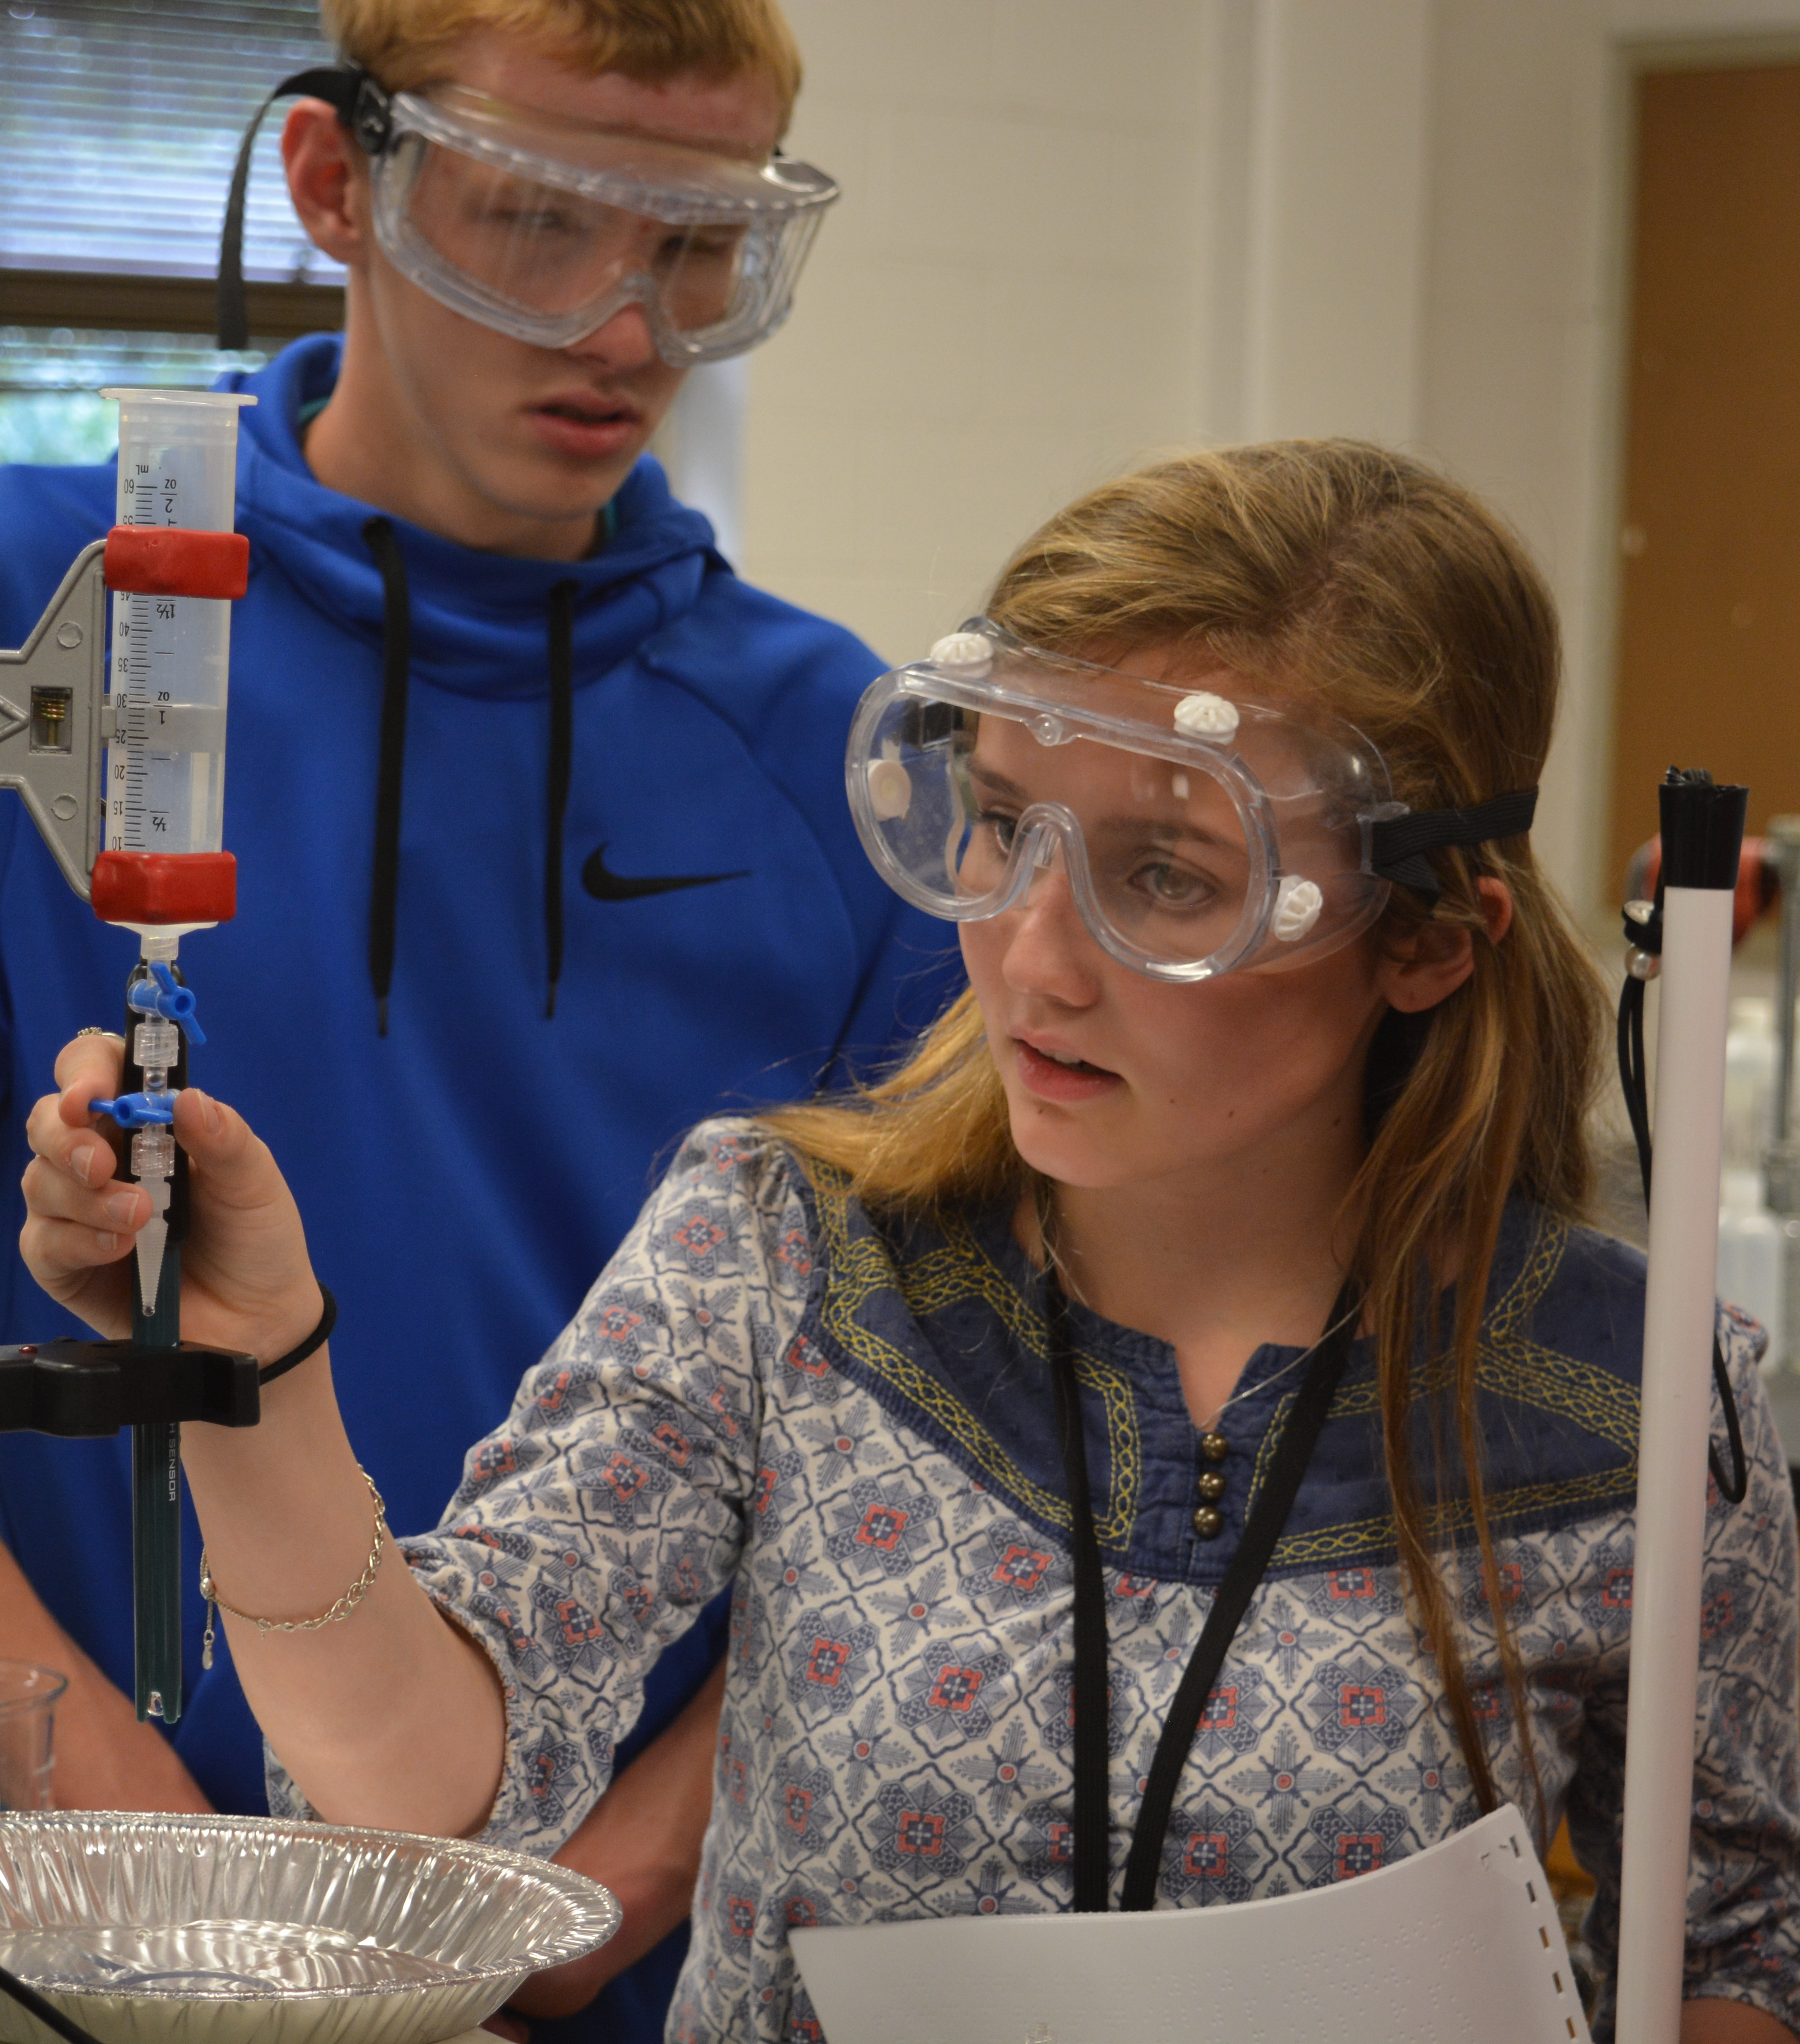
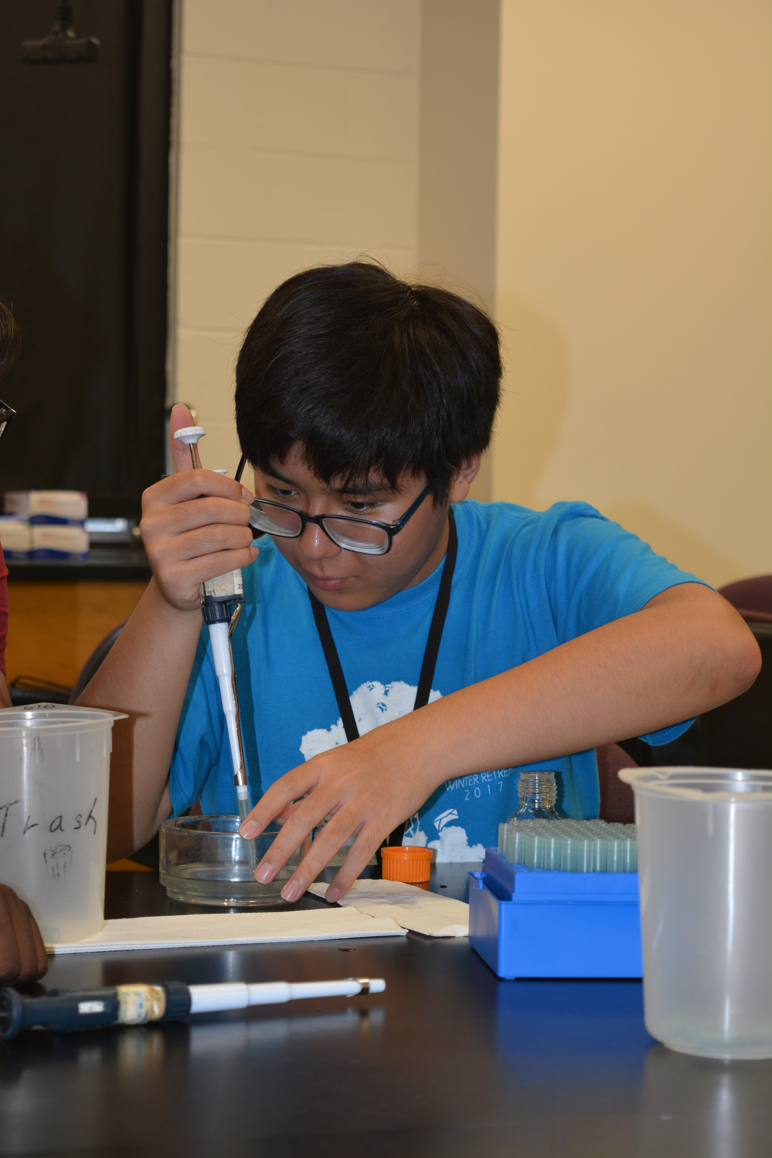
1. Embrace Nonvisual Ways of Learning
STEM is spatial
We don’t rush in to “help”

Slide 23
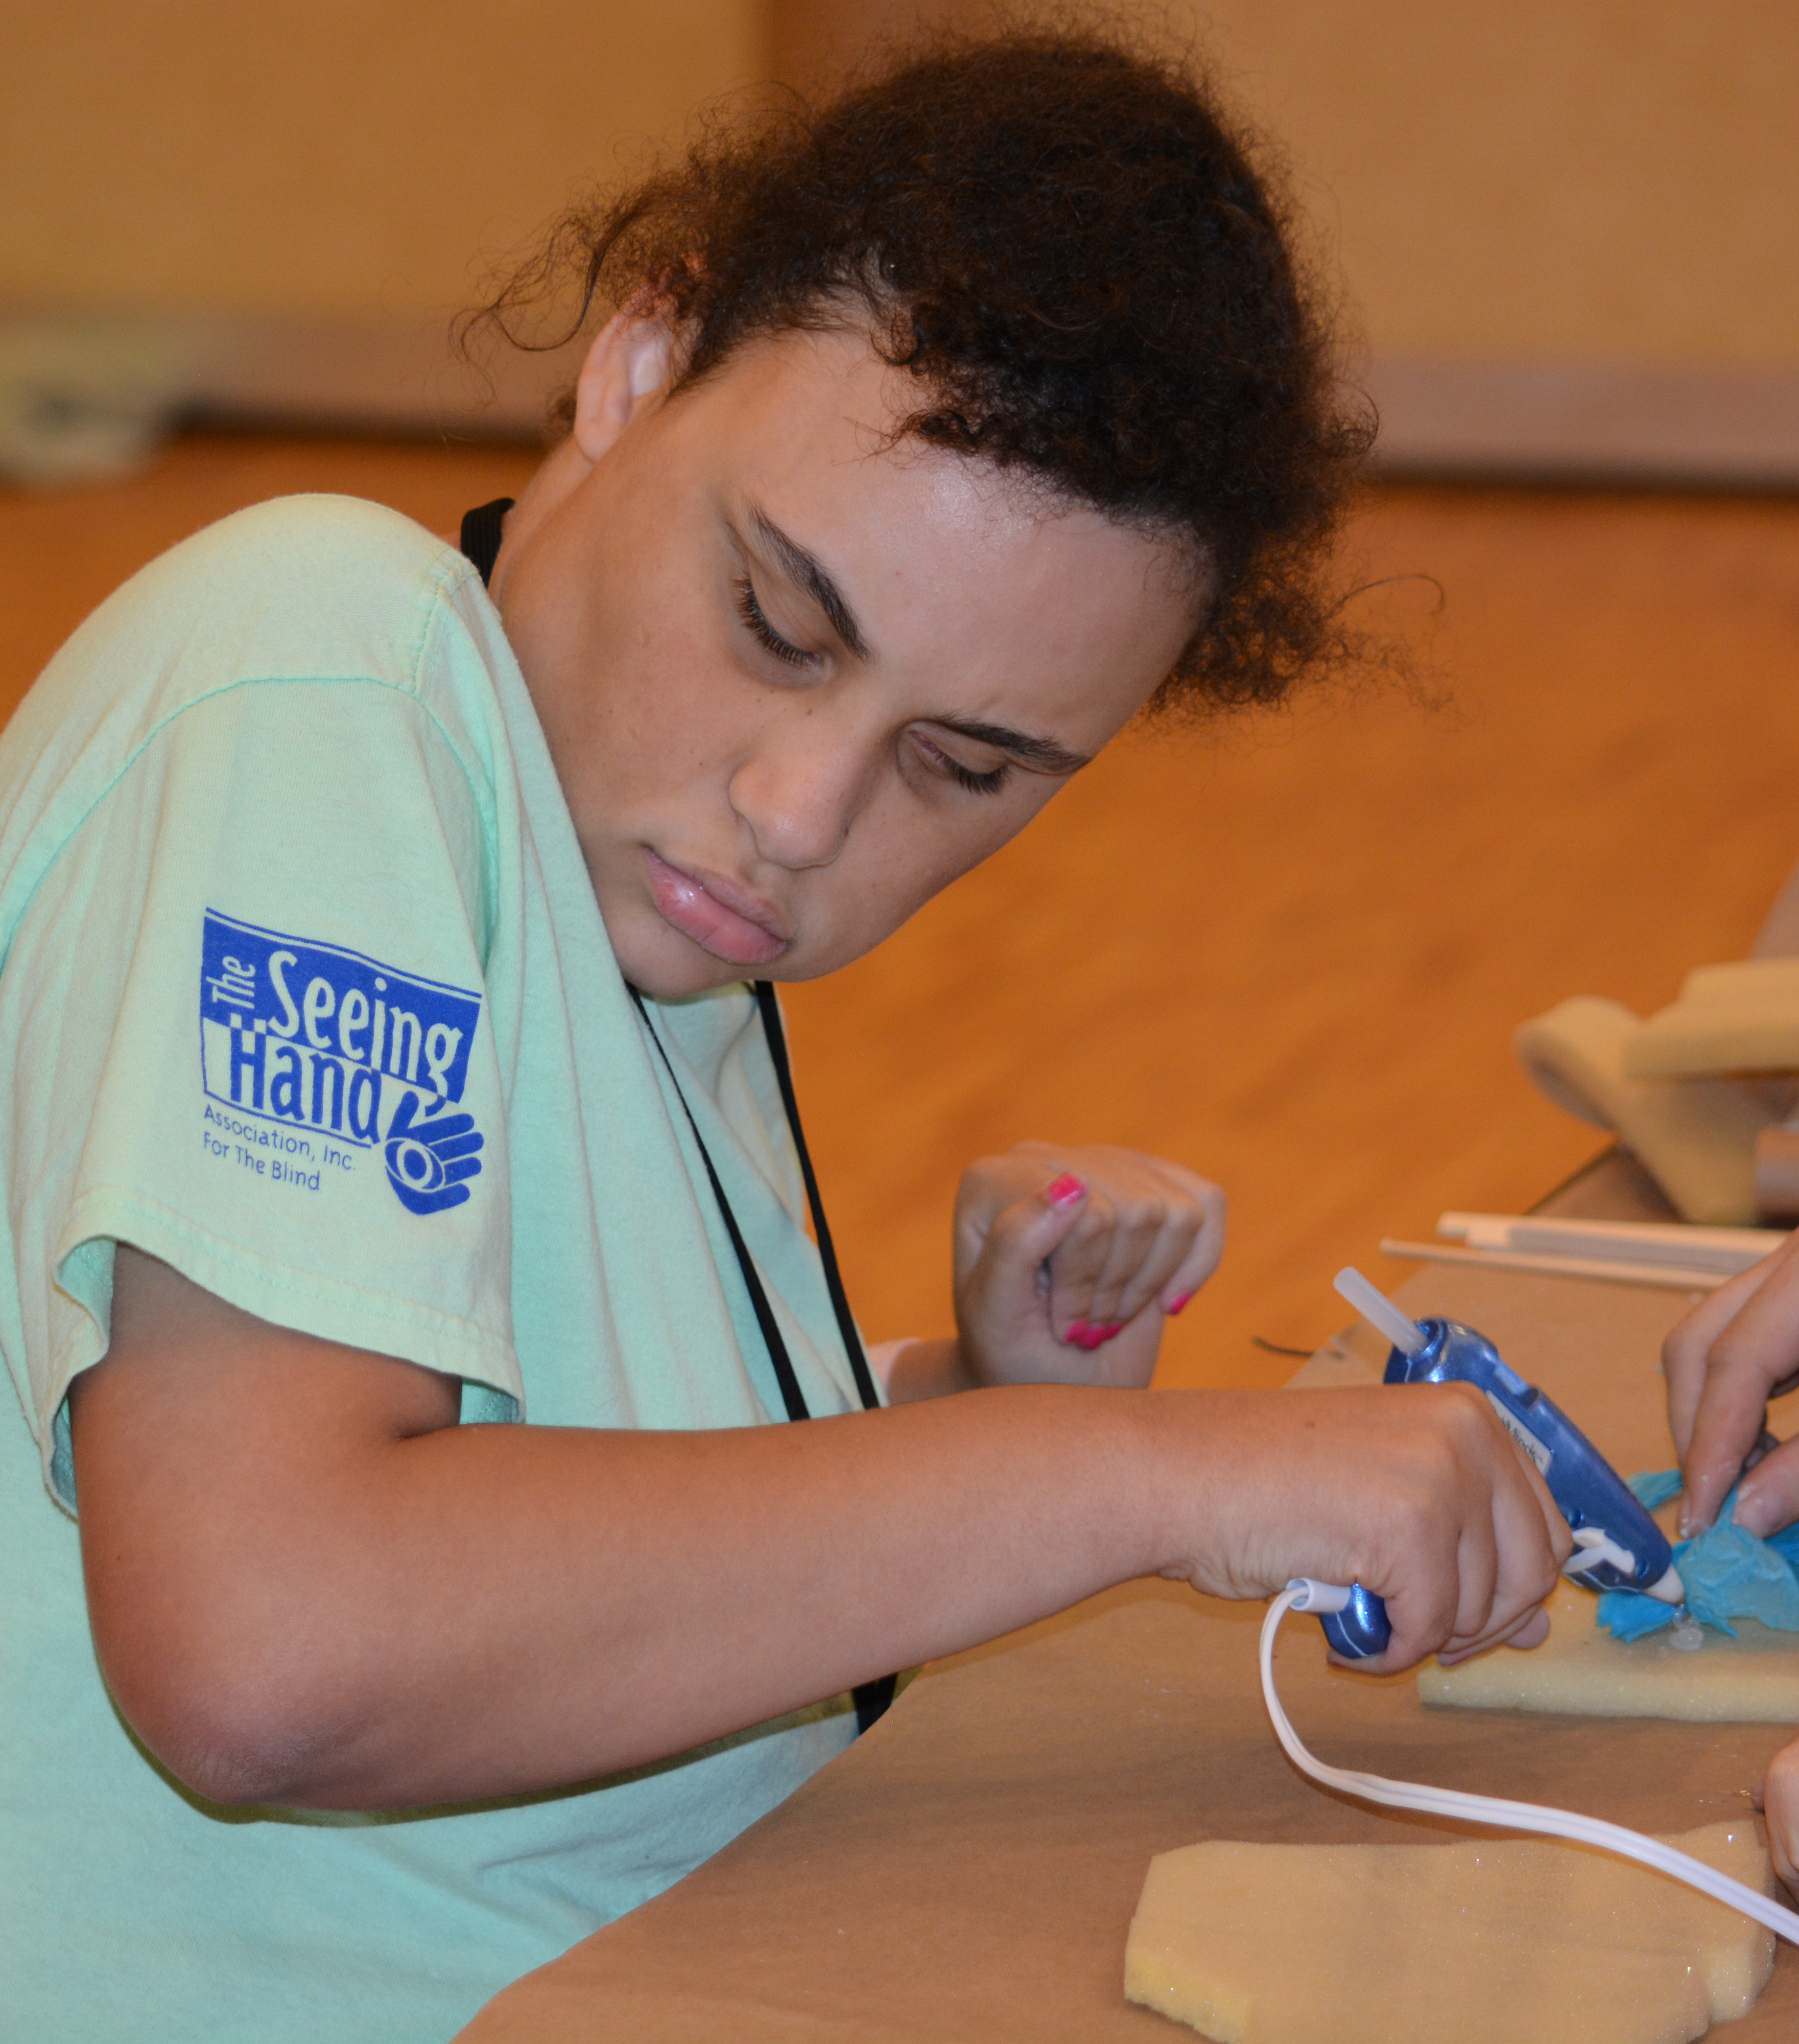
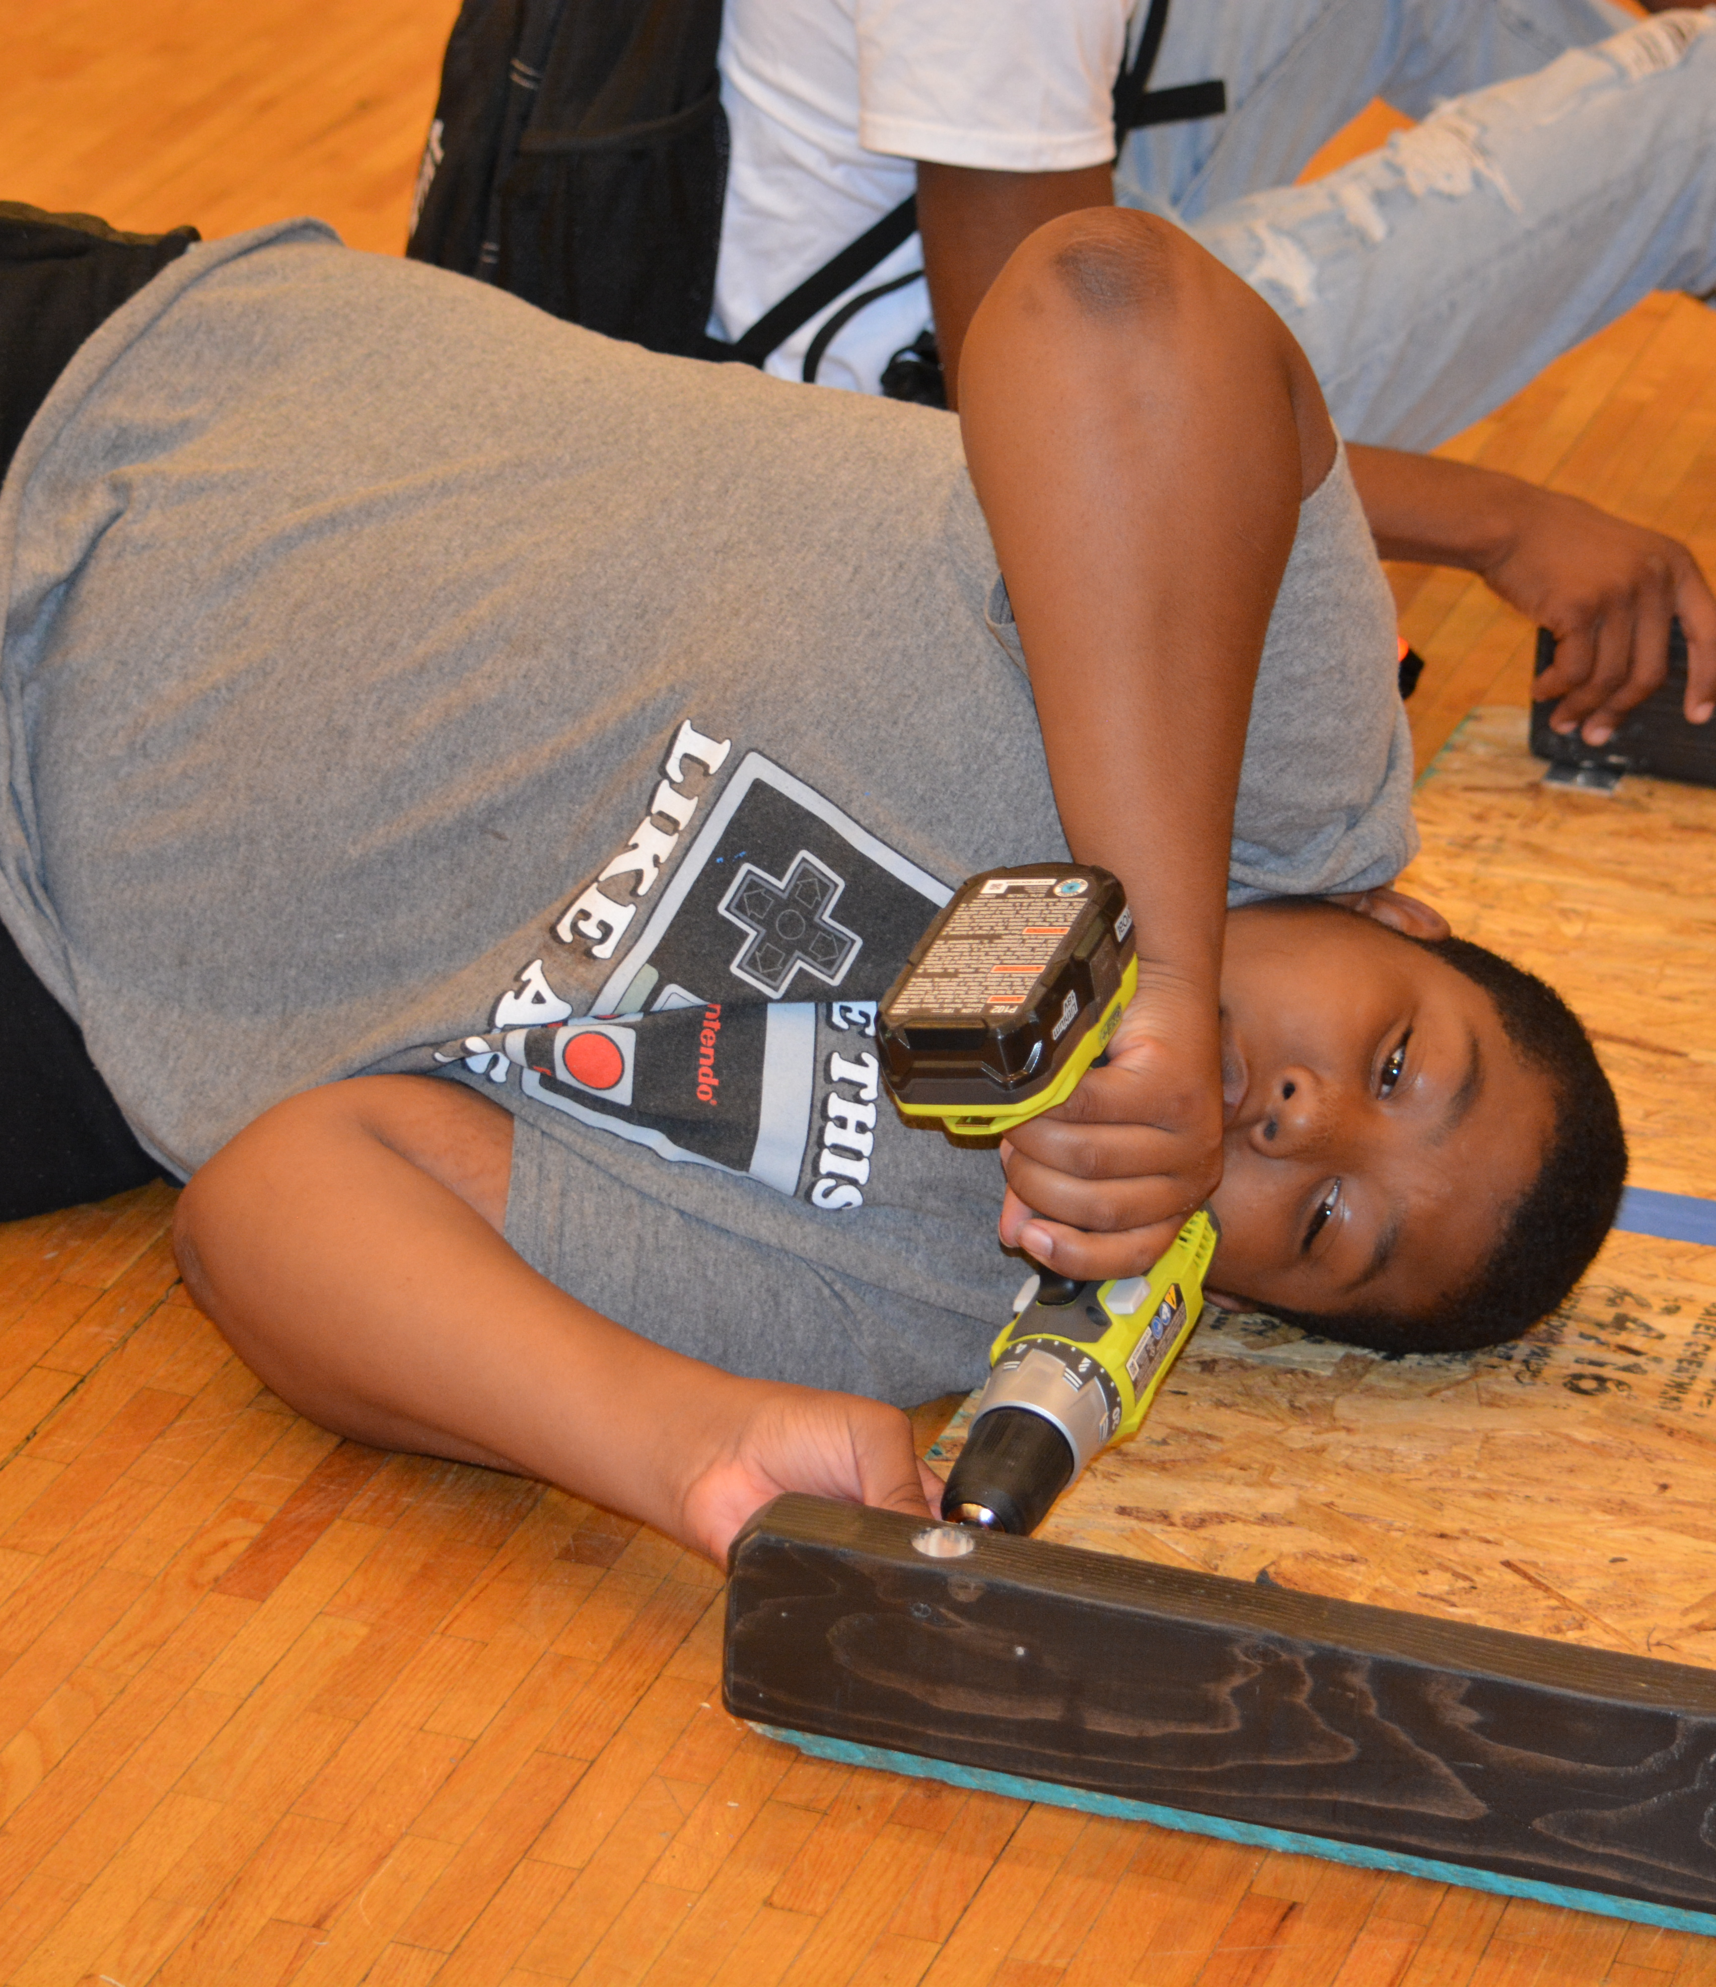
2. Create Empowering Environments
Do ALL aspects of an activity especially the “dangerous” parts

Slide 24
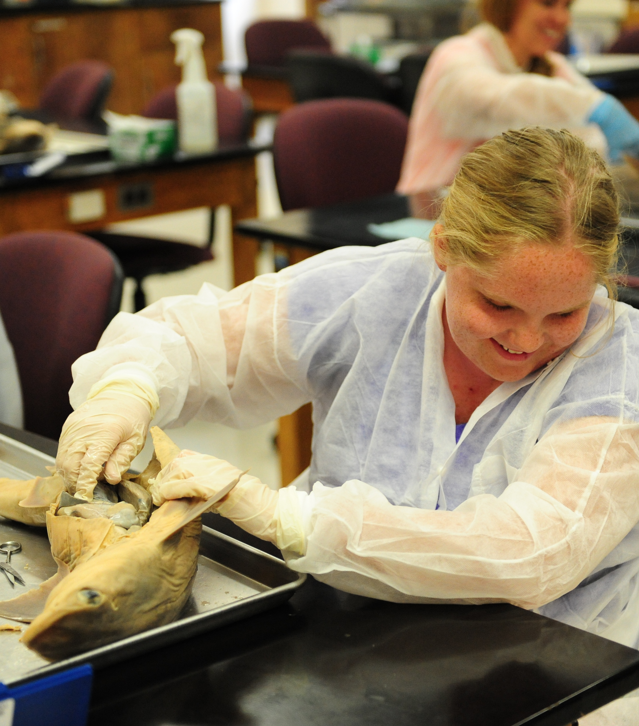
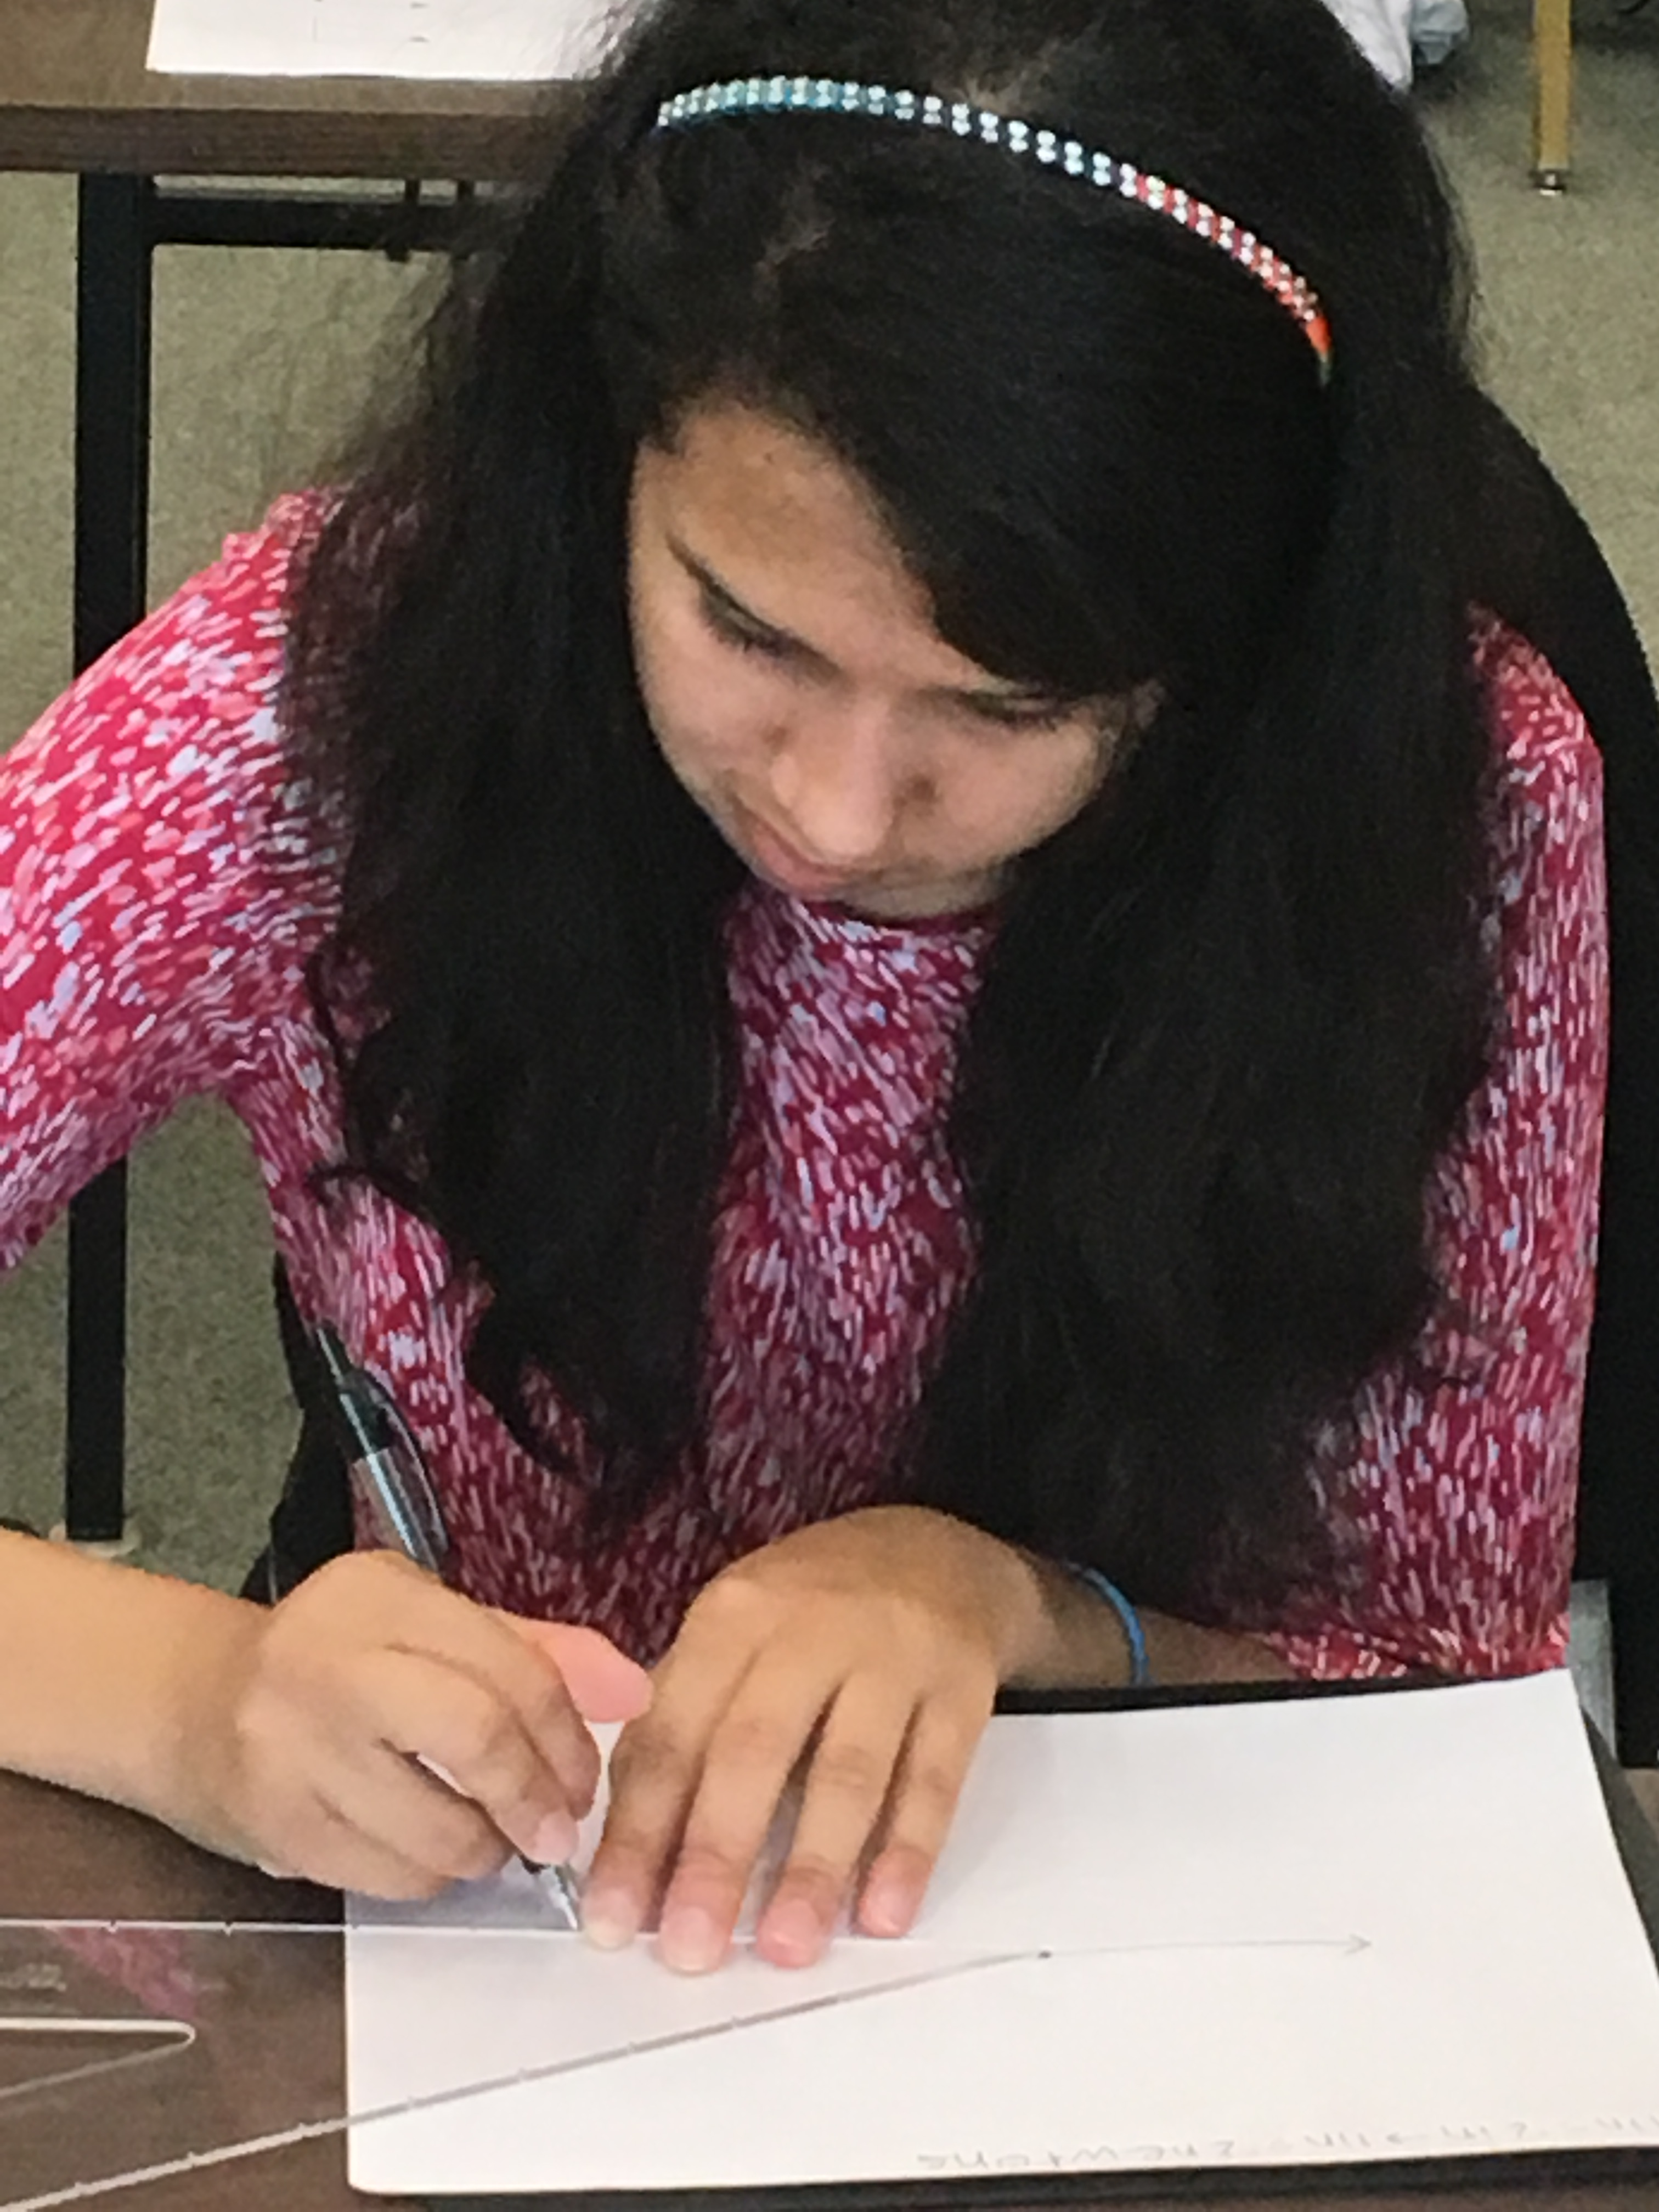
3. Teach nonvisual Science & Engineering practices
Observing, measuring, building, and communicating findings nonvisually

Slide 25
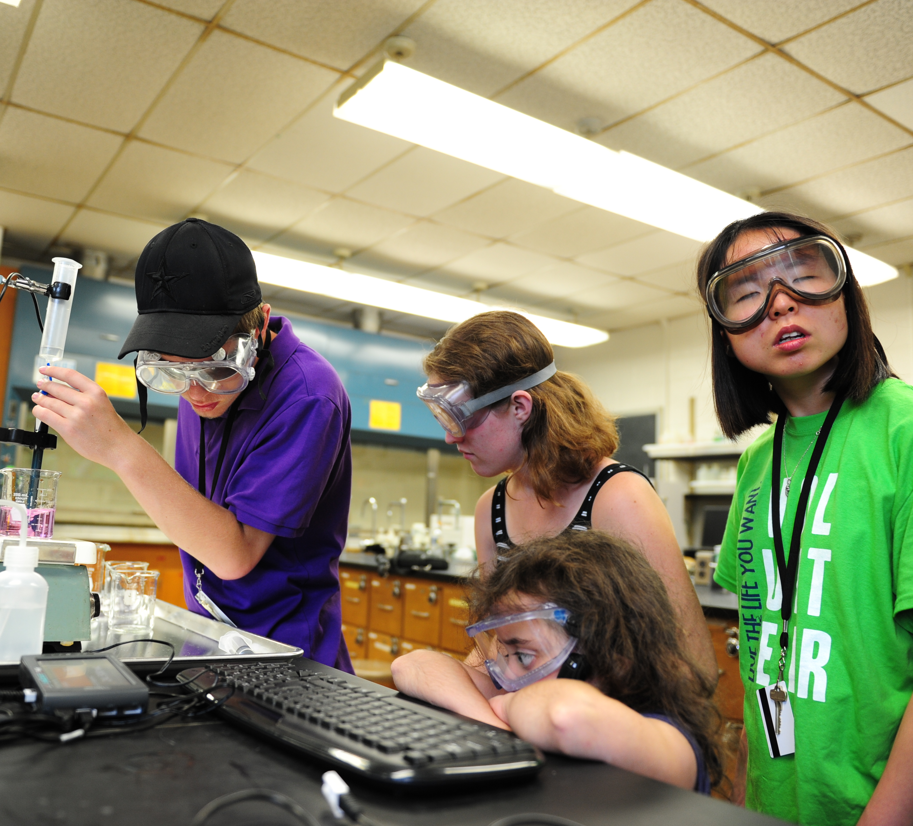
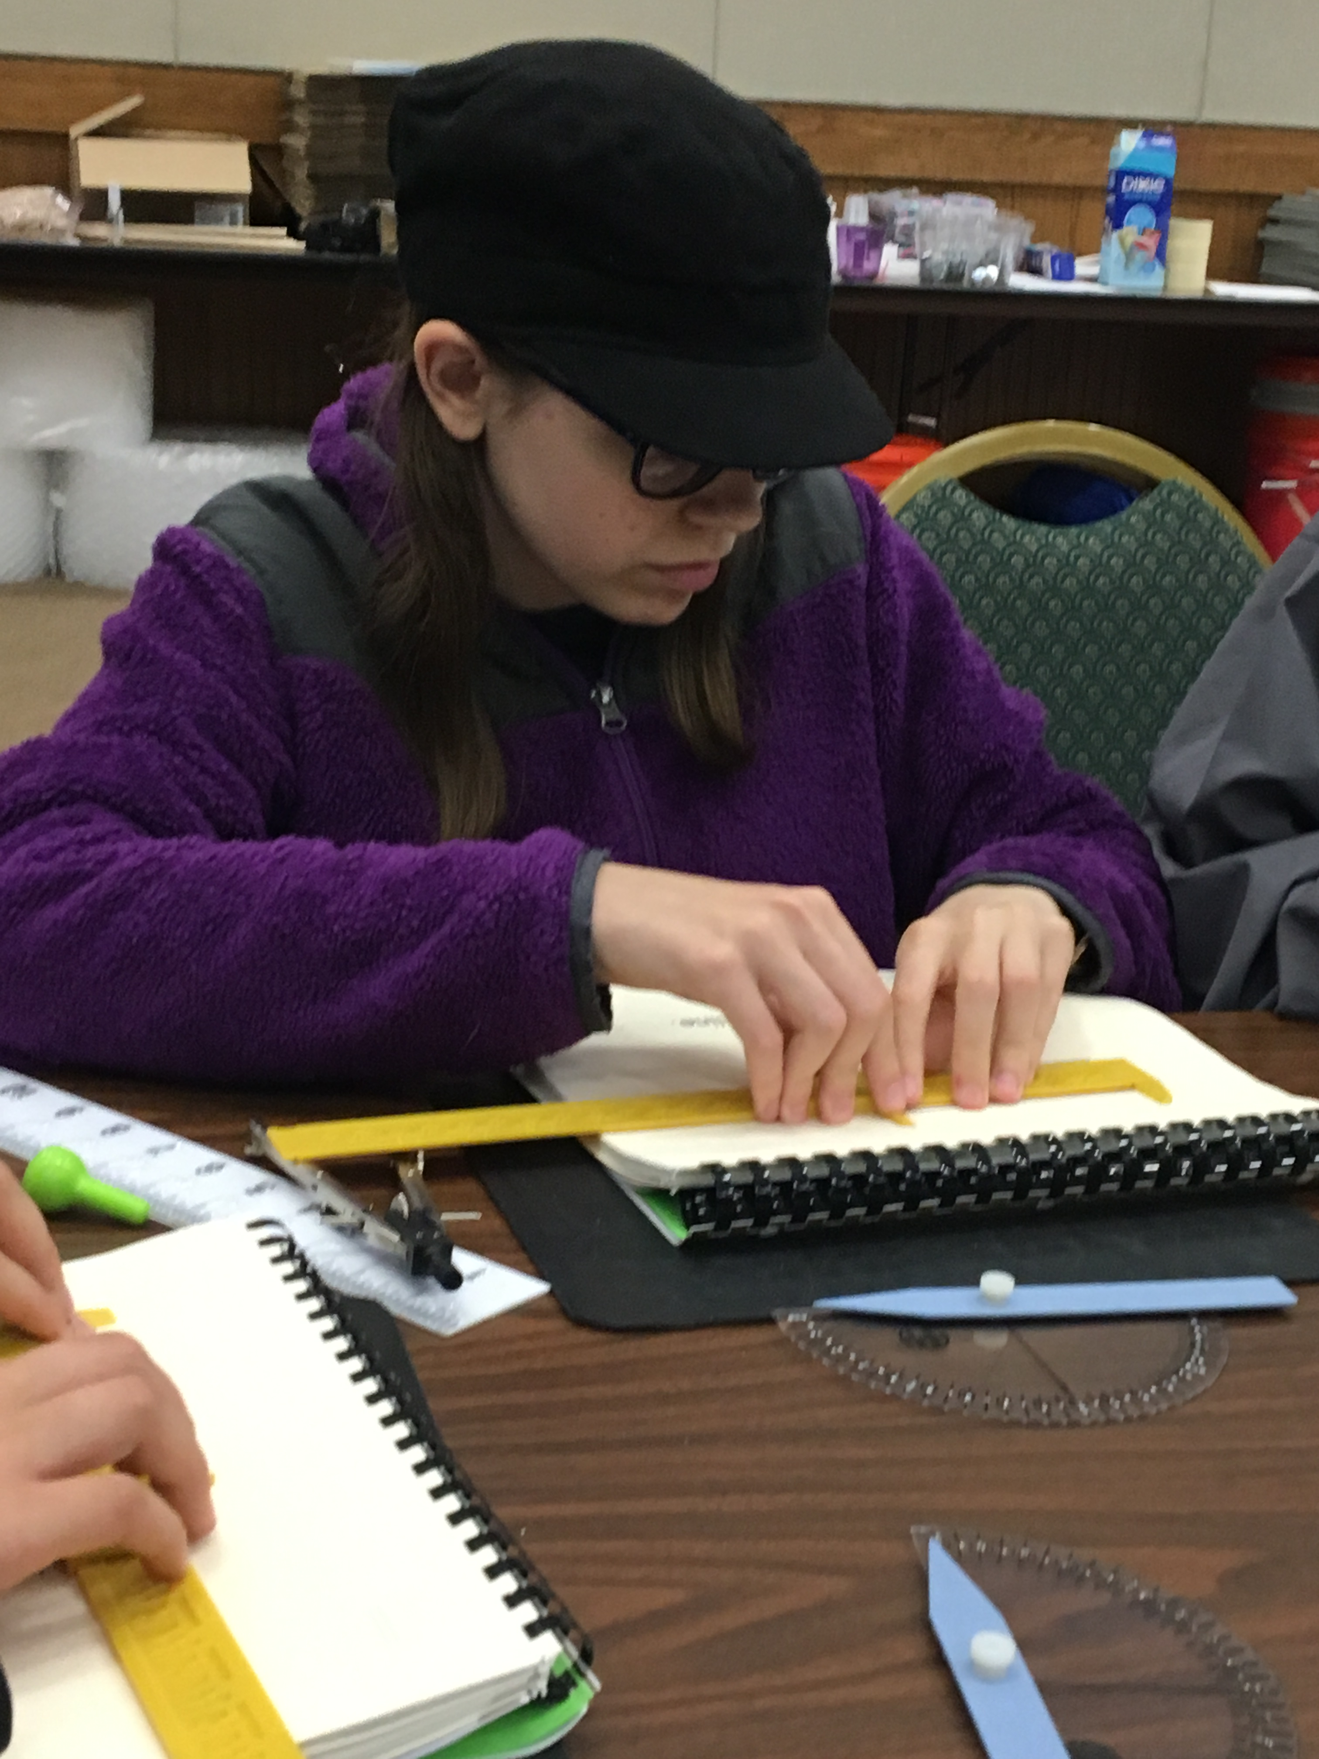
4. Use Accessible Equipment
SciVoice Talking LabQuest

Slide 26
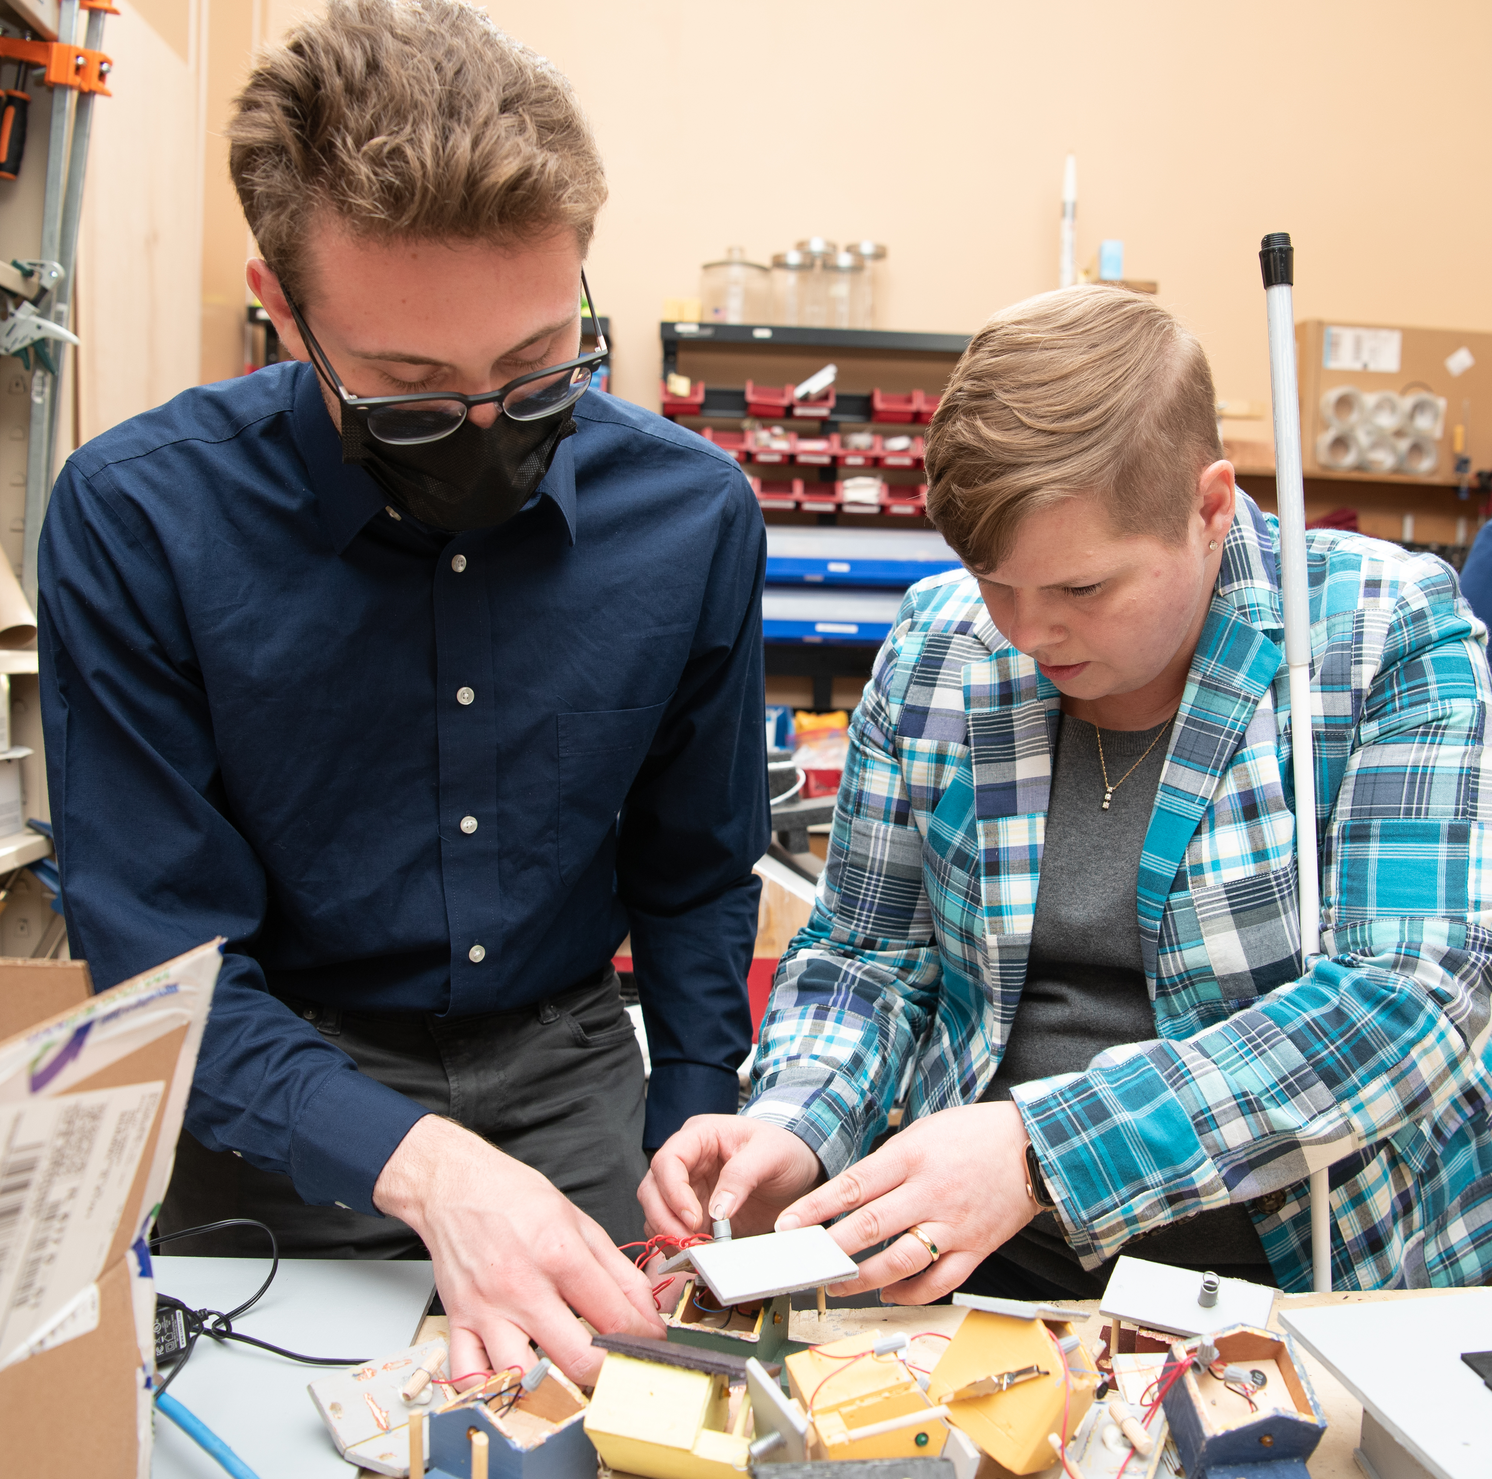
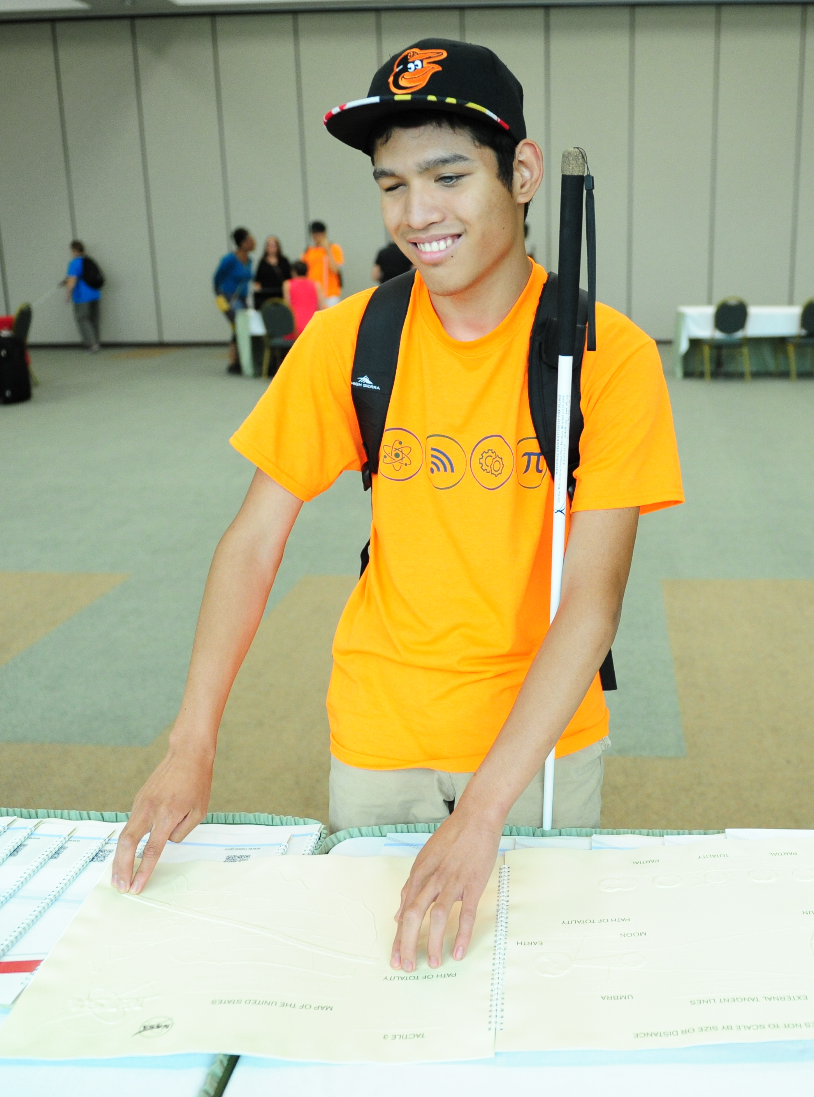
5. USE Accessible Instructional Materials
Braille
Accessible digital materials

Slide 27
ALL 5 Principles
To disrupt compulsory sightedness

Slide 28
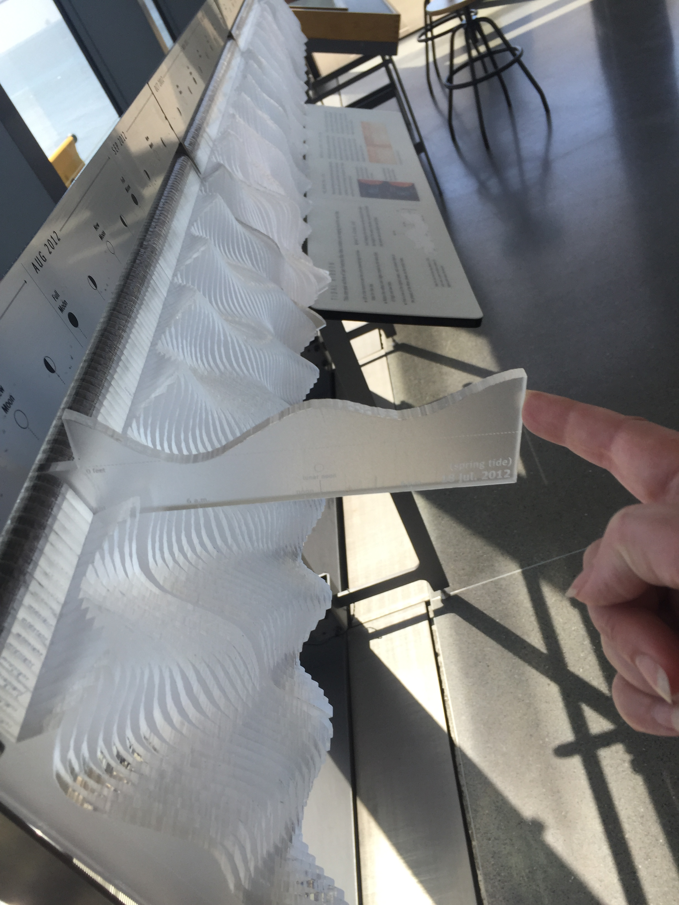
Museums
Exhibit text in Braille and print

Slide 29
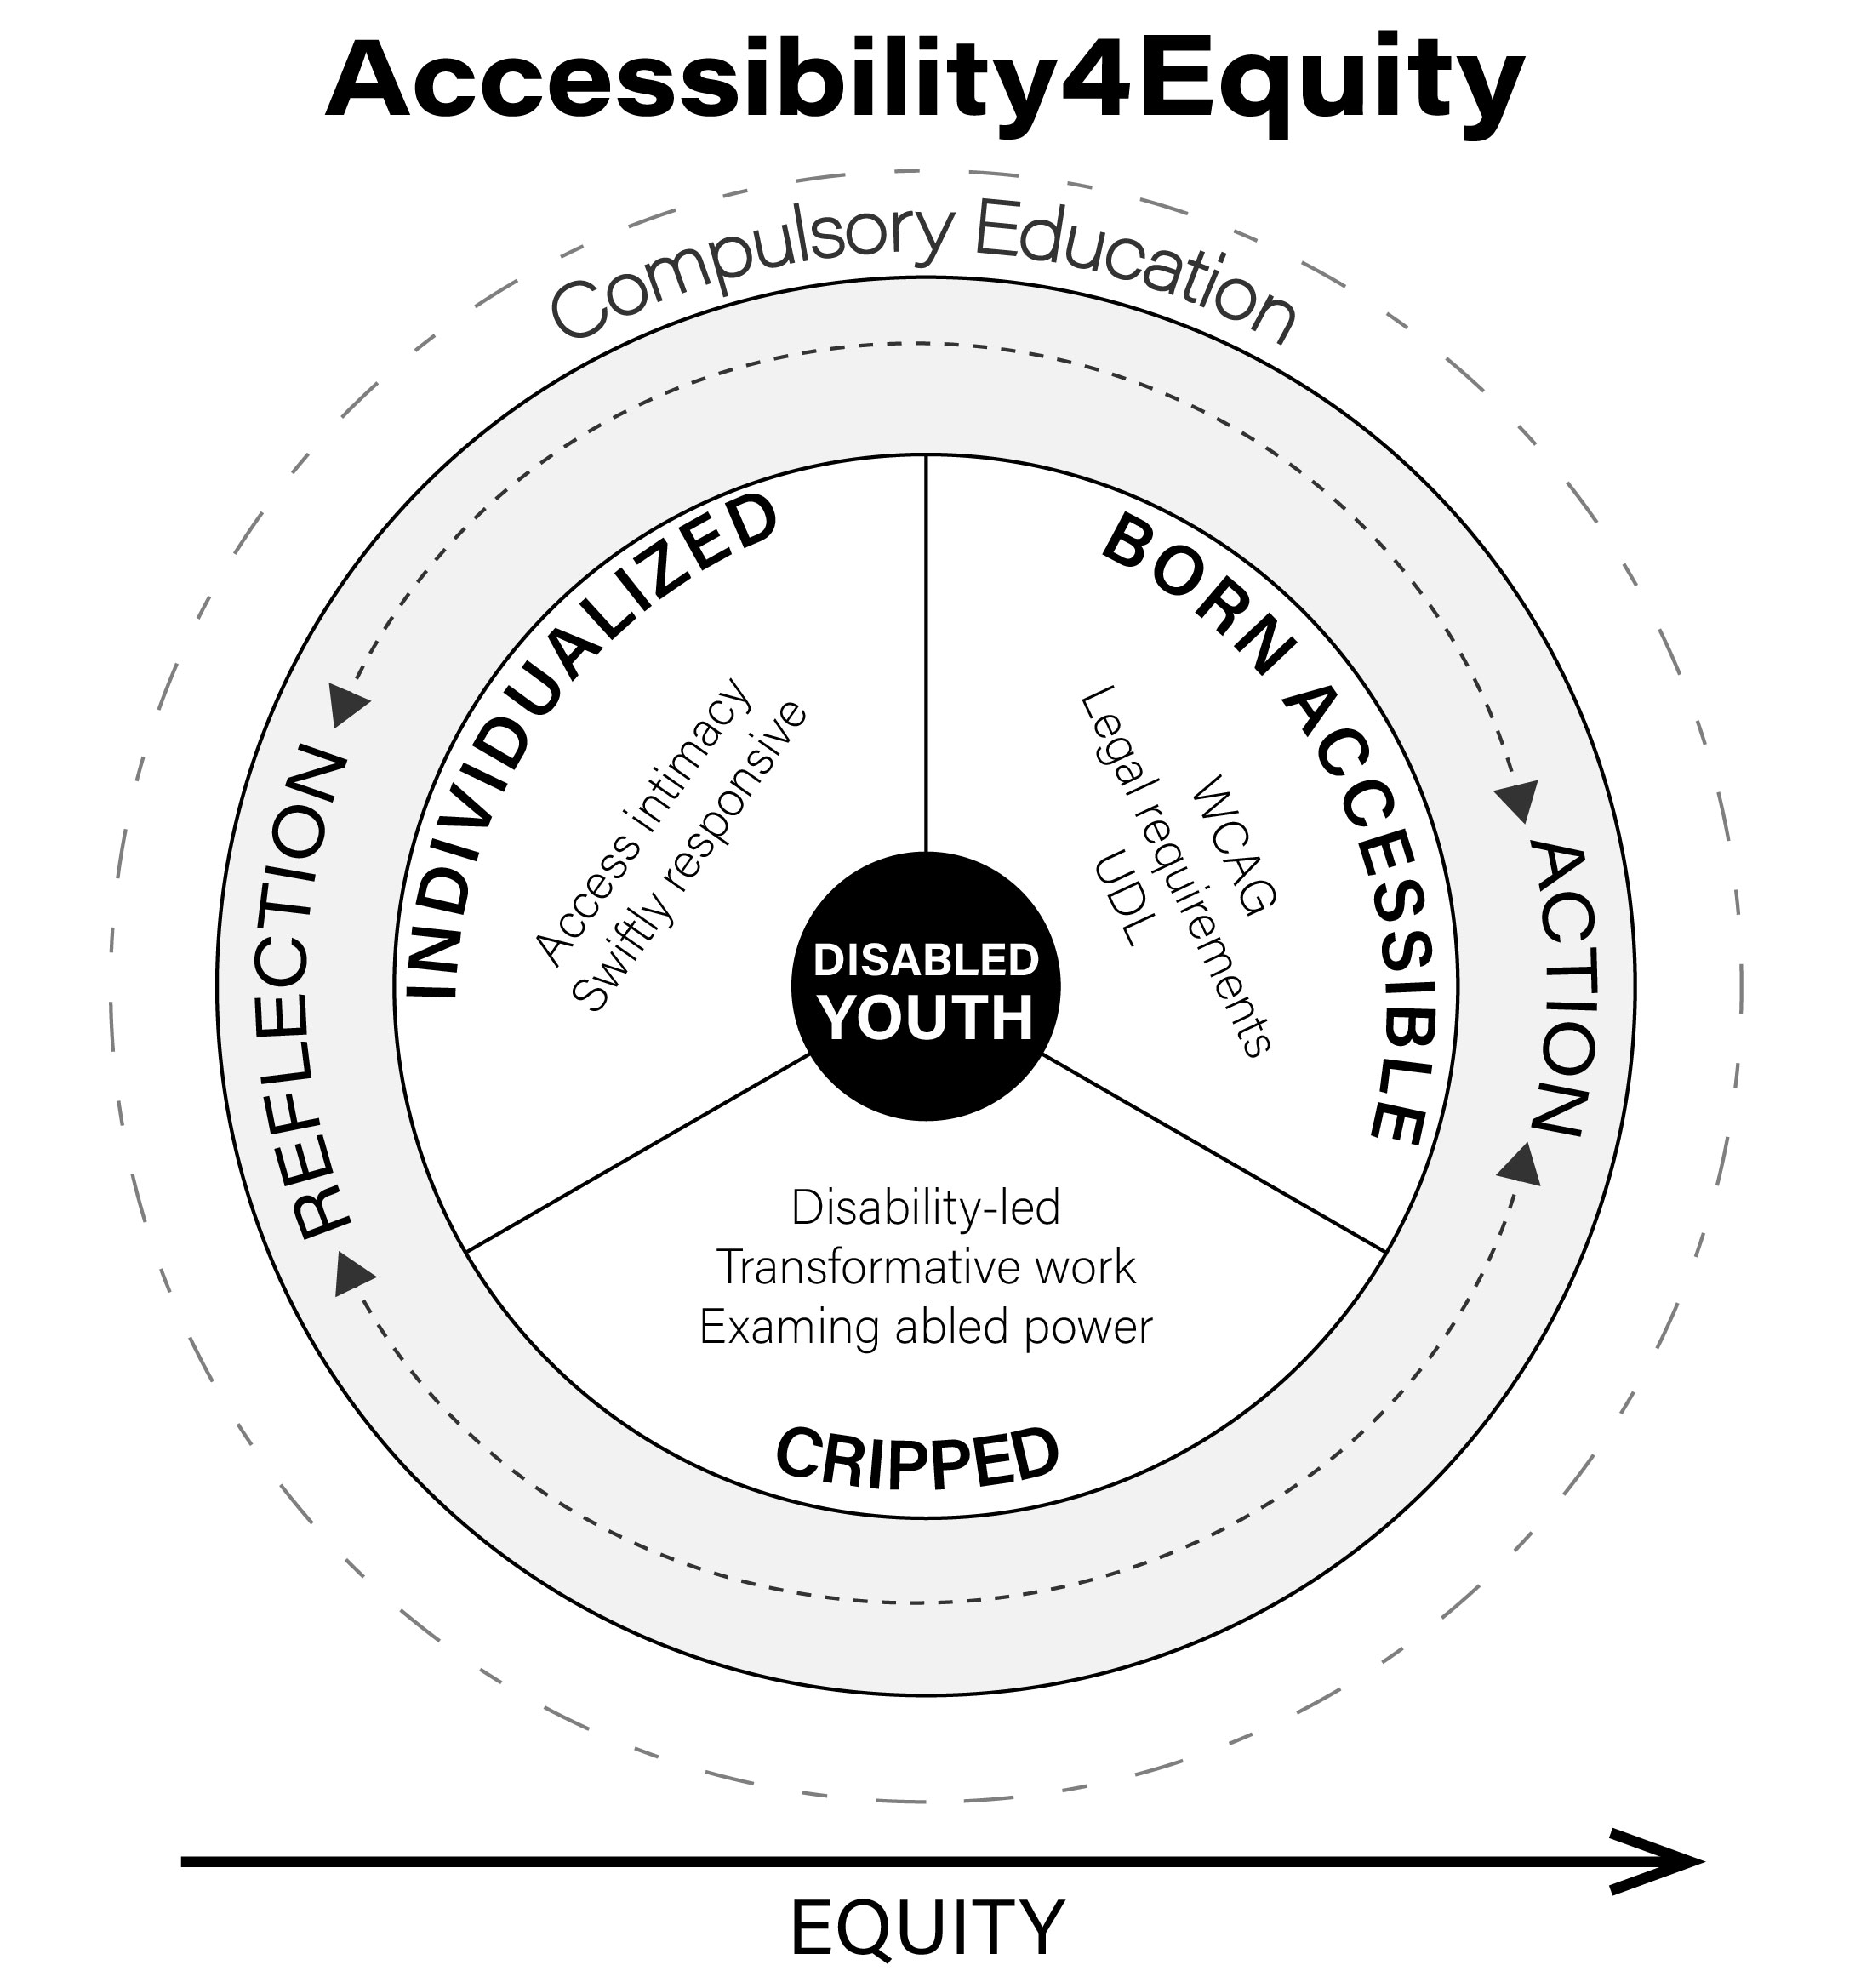
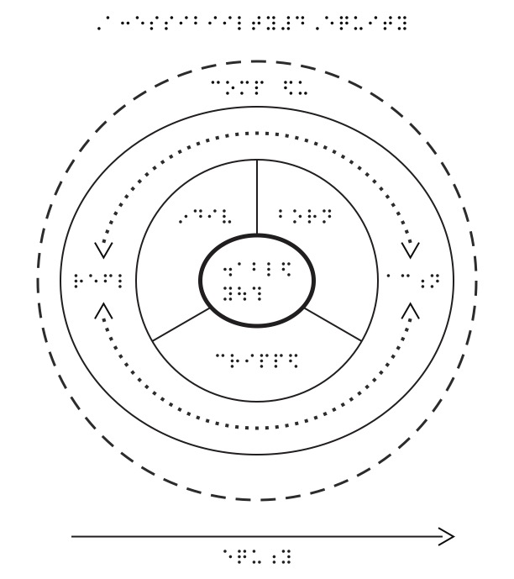
Dissemination
Chaffee Amendment (17 U.S.C. 121 & 121A)

Slide 30
How can YOU conspire with the blind community to change the unjust status quo in STEM?

Slide 31

Heroism
Inventing “solutions” to “problems” sighted folks think blind folks have

Slide 32
Ways to Conspire
Level 1: Hang up your cape
Level 2: Notice
Level 3: Digital accessibility (WCAG 2.2 Level AA)
Level 4: STEM Outreach & Communication activities that embrace nonvisual ways of learning

Slide 33

Will You Conspire with us?

Slide 34
Thank you
Learn More:
nlshaheen.com/OSU

Slide 35
References
17 U.S.C. 121 & 121A
20 CFR § 404.1581
Jernigan, K. (1962). A definition of blindness. Blind American. https://nfb.org/blog/definition-blindness
McRuer, R. (2006). Crip Theory: Cultural Signs of Queerness and Disability. NYU Press

Slide 36
Image credits
Kücklich, J. (2021). Accessibility. https://commons.wikimedia.org/wiki/File:Accessibility.png
Openclipart (n.d.) Thought Cloud. https://publicdomainvectors.org/en/free-clipart/Thought-cloud-vector-clip-art/7246.html
Openclipart (n.d.) Female Eye Line Art. https://www.google.com/imgres?imgurl=https%3A%2F%2Ffreesvg.org%2Fimg%2FAuge-lineart.png&imgrefurl=https%3A%2F%2Ffreesvg.org%2Ffemale-eye-line-art-vector-graphics&tbnid=jmEAaEWbvdZ3RM&vet=12ahUKEwjAhZnuls_9AhVm2ckDHWOzDm8QMygIegUIARCnAg..i&docid=0p5SQqpaM44YCM&w=600&h=600&q=eye&hl=en&client=safari&ved=2ahUKEwjAhZnuls_9AhVm2ckDHWOzDm8QMygIegUIARCnAg
Alvy16 (2018). PH Scale. https://commons.wikimedia.org/wiki/File:PH_scale_3.jpg
Openclipart (n.d.) Empty Speech Bubble. https://www.google.com/imgres?imgurl=https%3A%2F%2Ffreesvg.org%2Fimg%2F1300738303.png&imgrefurl=https%3A%2F%2Ffreesvg.org%2Fempty-speech-bubble&tbnid=dmg0hrfgKOjc5M&vet=12ahUKEwi8-8_KwdH9AhXPKd4AHR9nA-4QMygFegUIARCvAQ..i&docid=5DvfjUClltrsyM&w=600&h=600&q=2%20speech%20bubbles%2C%20transparent%20background&hl=en&client=safari&ved=2ahUKEwi8-8_KwdH9AhXPKd4AHR9nA-4QMygFegUIARCvAQ
Openclipart (n.d.) Science Flask Symbol. https://www.google.com/imgres?imgurl=https%3A%2F%2Ffreesvg.org%2Fimg%2Fchemical.png&imgrefurl=https%3A%2F%2Ffreesvg.org%2Fscience-flask-symbol&tbnid=y4aVFGwG4snRXM&vet=12ahUKEwilrPm8x9H9AhUhwuUKHRanB44QMygBegUIARCVAg..i&docid=2KaFkIOxGRDGlM&w=600&h=600&q=science&hl=en&client=safari&ved=2ahUKEwilrPm8x9H9AhUhwuUKHRanB44QMygBegUIARCVAg

Slide 37
Image credits (cont)
Openclipart (n.d.) Magnifying Glass. https://www.google.com/imgres?imgurl=https%3A%2F%2Ffreesvg.org%2Fimg%2F1533740278.png&imgrefurl=https%3A%2F%2Ffreesvg.org%2F1533740278&tbnid=yapI6aGS6obLVM&vet=10CDgQMyh6ahcKEwjw4uOBytH9AhUAAAAAHQAAAAAQAg..i&docid=24cM22lSTNHz3M&w=600&h=600&q=magnifying%20glass%20eye&hl=en&client=safari&ved=0CDgQMyh6ahcKEwjw4uOBytH9AhUAAAAAHQAAAAAQAg
Consumer Financial Protection Bureau (2018). Bullhorn. https://commons.wikimedia.org/wiki/File:Bullhorn_%2889664%29_-_The_Noun_Project.svg
Openclipart (n.d.) Incandescent Lightbulb Pictogram. https://publicdomainvectors.org/en/free-clipart/Vector-image-of-incandescent-light-bulb-pictogram/23310.html

